Slide 1

Optimization Project
Group Members : Mohit Kumar Ahuja, Anirudh, Darja
5 January 2017

Slide 2
Introduction
Goal: to match 3 clouds of points by aligning them together.
Approach Used:
Finding Minimum
Using ICP

Slide 3
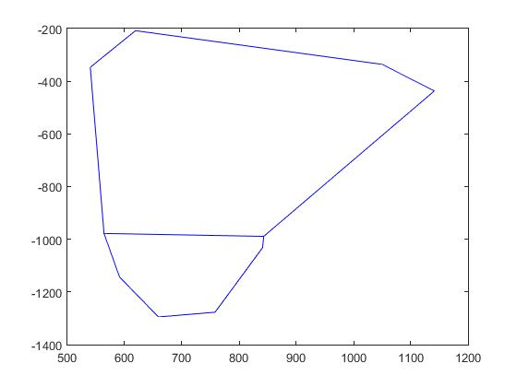
Finding Minimum
Binary of Images.
Detect Boundary of object.
Vertices Reduction.
Calculated Slope of all finalized sides of object outline.
Compared all sides of Object A and Object C by calculating Slope.
Find minimum from all the values in the matrix formed.
The coordinated corresponding to minimum value are the matched planes.
Transformation using Affine matrix.

Slide 4
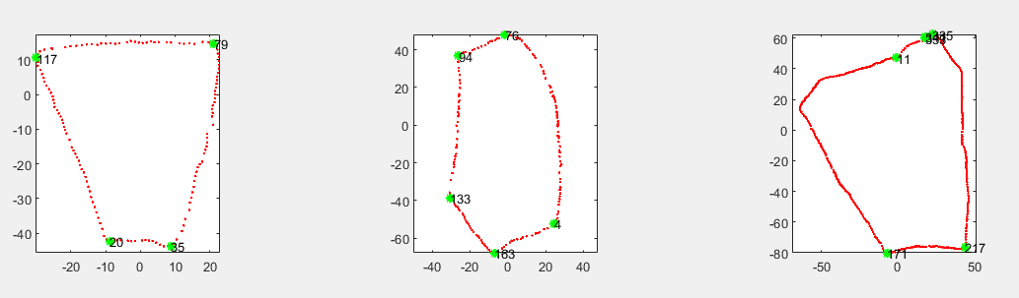
ICP Method
Point clouds were first denoised – pcdenoise function
Obtained a 2d cloud by selecting small range of values for z.
Generated a boundary structure of each cloud by using ‘Boundary’ function
Computed the vertices of each obtained polygon by iterating over each point while detecting change in slope.
Figure 1Boundary images with vertices shown in green

Slide 5
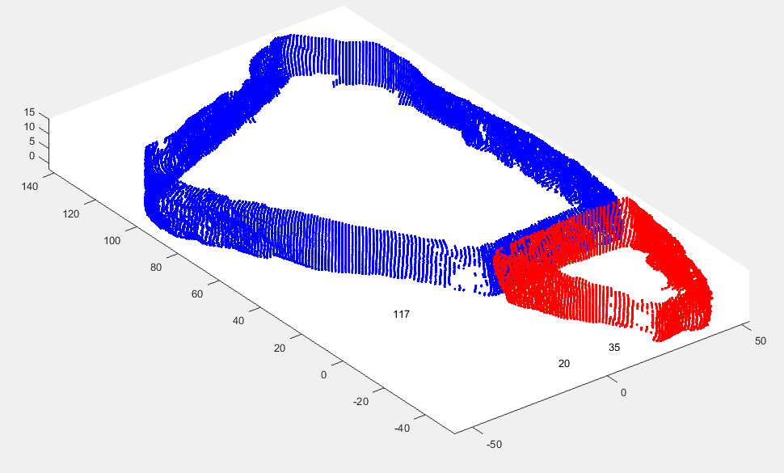
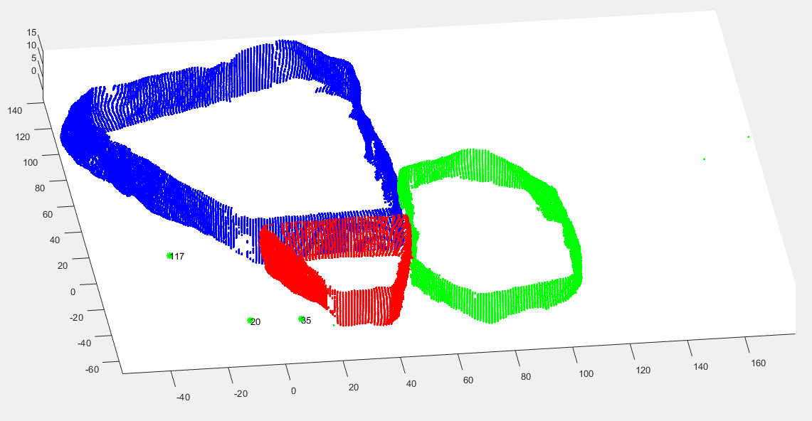
ICP Method
Used ICP over the computed edges to find the best match for the edges
ICP was not giving good results for adding the 3rd point cloud.
Hence, subtracted value of one particular vertex of cloud from entire cloud to bring the vertex of interest to a common origin.
Result obtained using ICP
Result generated from translating the clouds to common origin

Slide 6
Conclusion
At least 2 Point clouds using finding minimum error method can be stitched.
ICP and finding minimum was successfully tested.
Methods were performed on 2D and extended to 3D.
Satisfactory results were obtained.

